Slide 1

NarrativeFlicks
"it's time to change the narrative"

Slide 2

Problem Statement
The traditional process of content creation often poses challenges for creators, requiring significant time, expertise, and resources. Additionally, existing platforms may lack intuitive tools for users to bring their narratives to life effectively. There's a growing need for a solution that simplifies the content creation process while offering advanced features for dynamic storytelling.

Slide 3

Solution
NarrativeFlicks addresses these challenges by offering an innovative platform that leverages advanced AI technology to transform narrations into dynamic visual stories.
This solution is comprehensive, encompassing several critical components:
AI-powered Narration Interpretation
Real-time Rendering Engine
Interactive Editing Tools
Multi-language Support
Dynamic Visual Effects Library

Slide 4
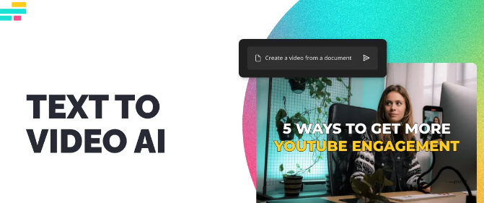
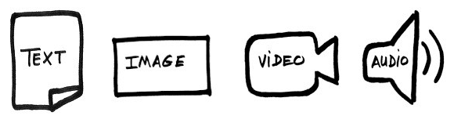
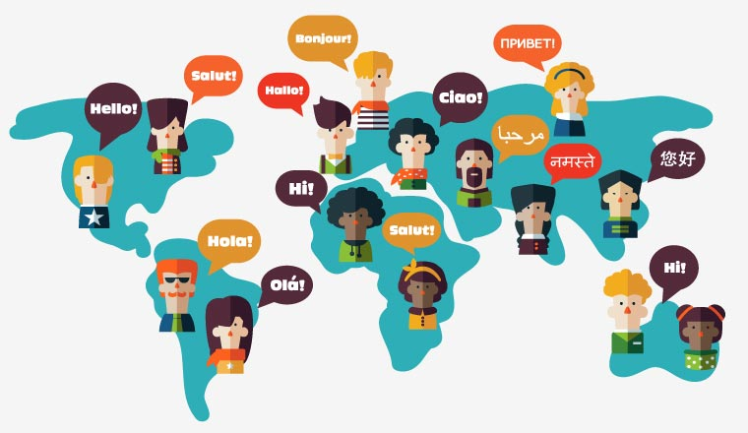
Key Product Specs
Narration to Video Generation
Various Input Format Support ( Audio, Text, Image)
Multi- Language Support
Customized Theme Options
Personal Voice Imitation
Music & Sound Effects Support

Slide 5

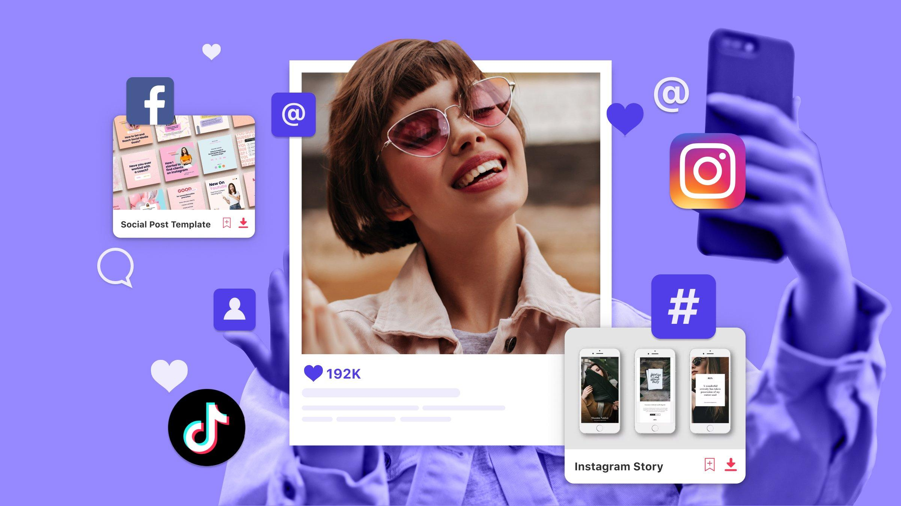
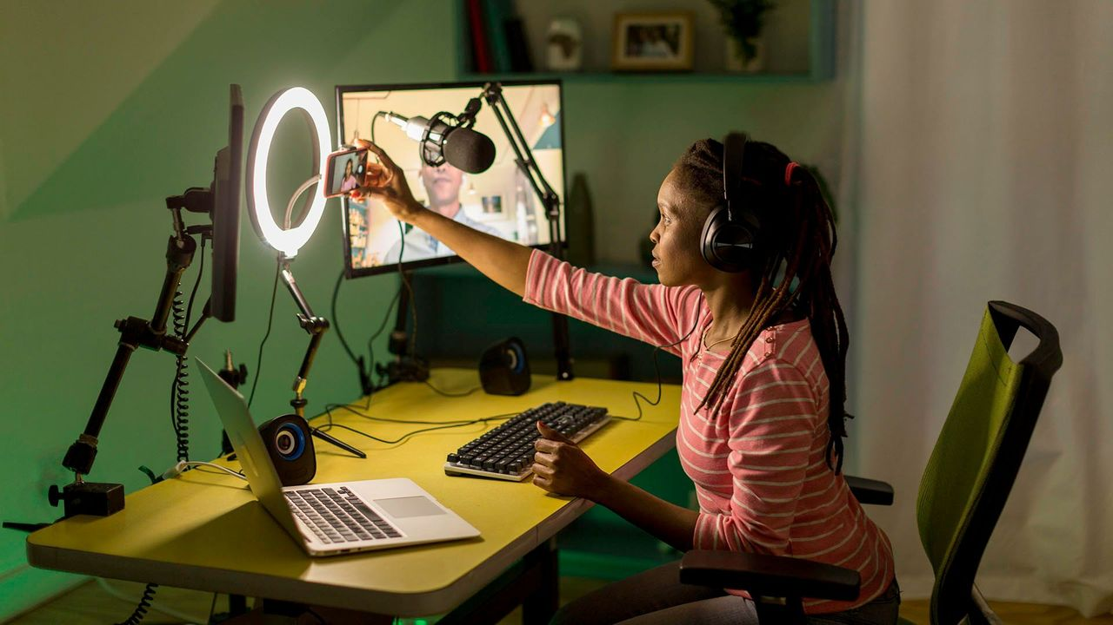

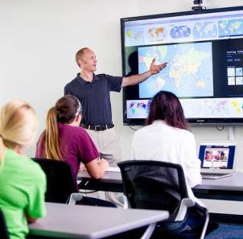
Key Partners

Slide 6
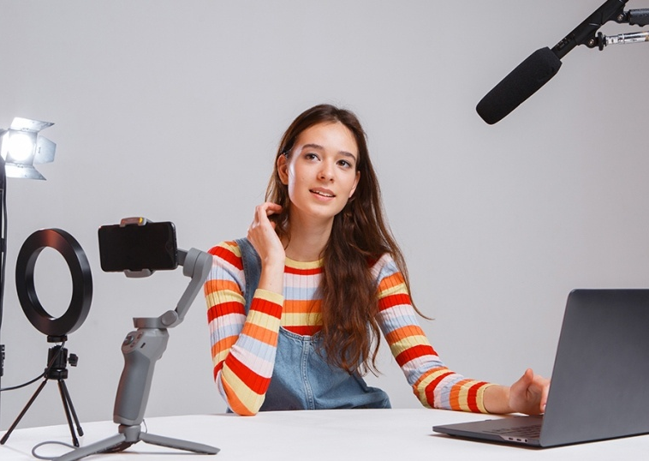
User Research & Personas
Needs: Sarah seeks advanced editing tools, real-time rendering, and multi-language support for her diverse projects.
Sarah: Creative Content Creator
Demographics: Female, 22 years old, freelance content creator with a bachelor's degree in Marketing.
Behavior: Active on social media platforms like Instagram, YouTube, and TikTok.

Slide 7

User Research & Personas
Needs: David desires interactive storyboarding, extensive educational content, and collaboration features to enhance his teaching methods.
Alex: Educational Instructor
Demographics: Male, 35 years old, educational instructor with a master's degree in Education.
Behavior: Passionate about multimedia learning.

Slide 8
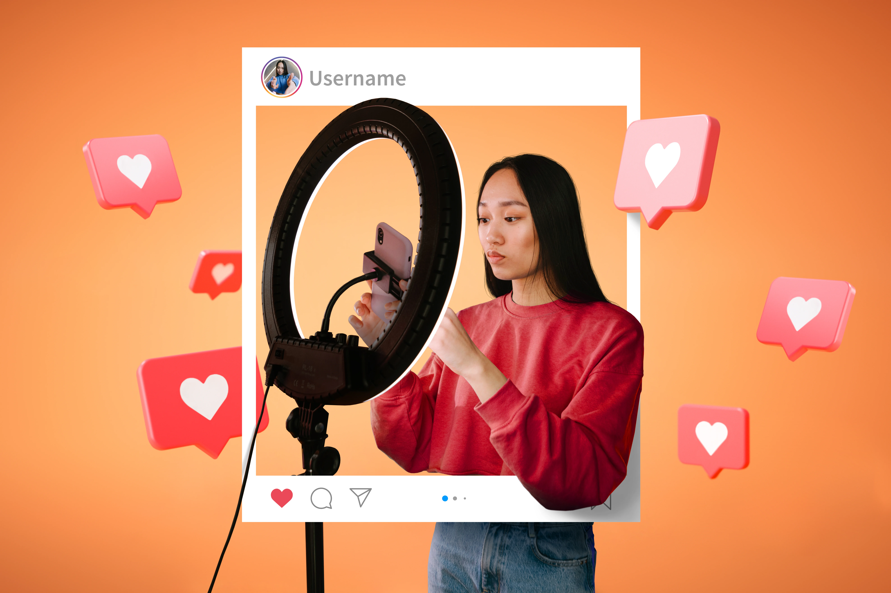
User Research & Personas
Needs: Emily seeks user-friendly interfaces, access to royalty-free music, guidance on storytelling, and seamless integration with social media for content distribution.
Emily: Social Media Influencer
Demographics: Emily, 23, a female aspiring social media influencer with a bachelor's degree in Communication Studies.
Behavior: Actively creating content.

Slide 9

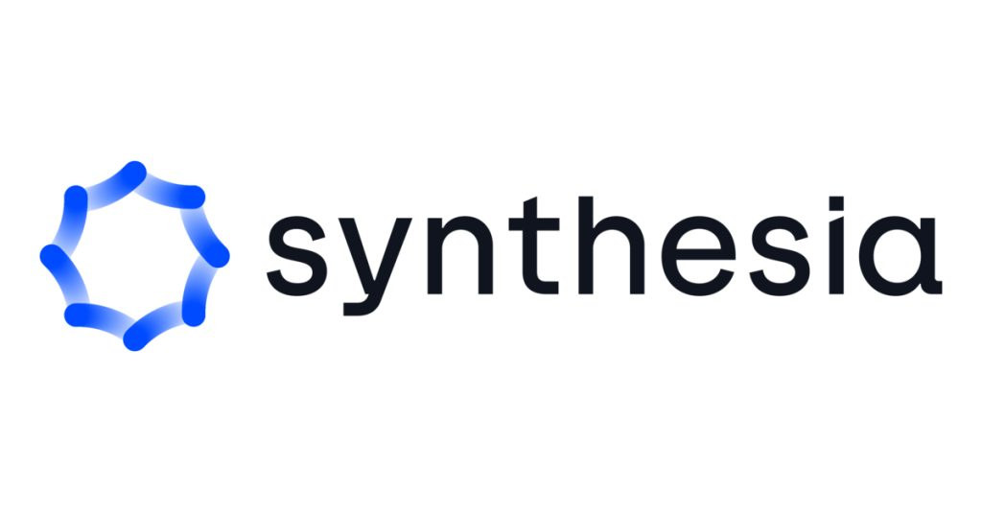
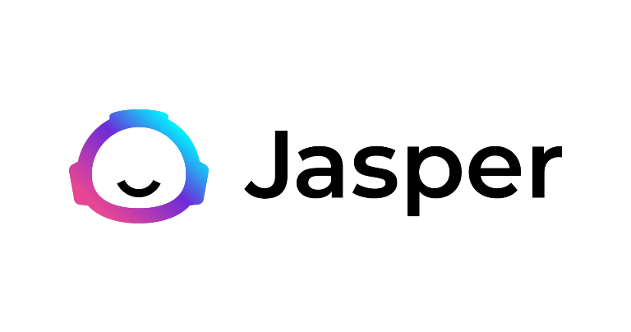


Competitor Analysis
Features
Narration to Video
Multi-Language Support
Human Voice Imitation
NarrativeFlicks

Slide 10

Market Size
Target Market
Social Media Creators (60 million users)
Educators and Trainers (57 million workers)
Businesses (32.5 million)
Market Size
The global video editing software market is expected to reach $1.7 billion by 2027, indicating a strong demand for video creation tools.
User-generated video content is projected to make up 82% of all internet traffic by 2024.

Slide 11
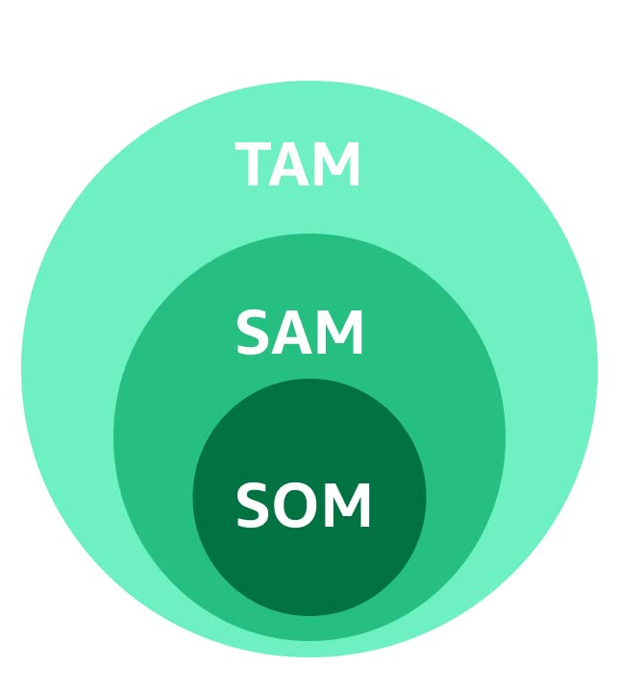
Market Analysis
TAM (Total Addressable Market): Represents the entire global market for the product.
According to Grand View Research, the global video editing software market is expected to reach $1.7 billion by 2027. This figure represents the TAM.
SAM (Serviceable Addressable Market): A segment of the TAM that you can realistically reach with our product.
Assuming 20% of social media creators, 30% of educators creating video content, and 10% of businesses interested in video creation would be interested in narration-based tools, we get a starting point for SAM: 32.35 million
SOM (Serviceable Obtainable Market): The most realistic and achievable portion of the SAM that you can convert into paying customers.
Assuming a 10% conversion rate of users in the SAM to paying subscribers translates to an SOM of: 3.235 million

Slide 12

Quantitative Insights
App downloads: Assuming a 1% capture rate of the target market (60M+57M+32.5M) within 3 years, downloads could reach 1.5 million.
Monetization: The app can offer a freemium model with basic features and paid subscriptions for premium features (e.g., video length, customization options). An average revenue per user (ARPU) of $5 per month with 10% paid user conversion translates to a potential monthly revenue of $75,000 within 3 years.

Slide 13

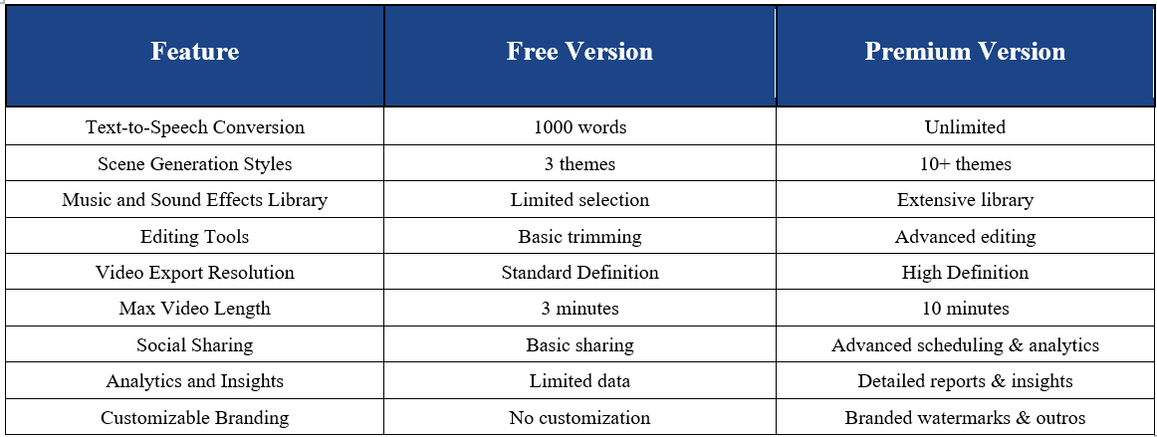
Revenue Streams

Slide 14


Prototypes and Assumptions
Prototype
AI-Driven Narration-to-Video Conversion
Real-time Rendering and Preview
Customization and Editing Tools
Multi-Language Support and Accessibility
Collaborative Storytelling Features
Assumptions
AI Accuracy and Coherence
User Engagement and Interface Usability
Editing Tools and Customization
Language Support and Accessibility
Collaborative Features Efficacy

Slide 15

Plan to Bring NarrativeFlicks to Market

Slide 16
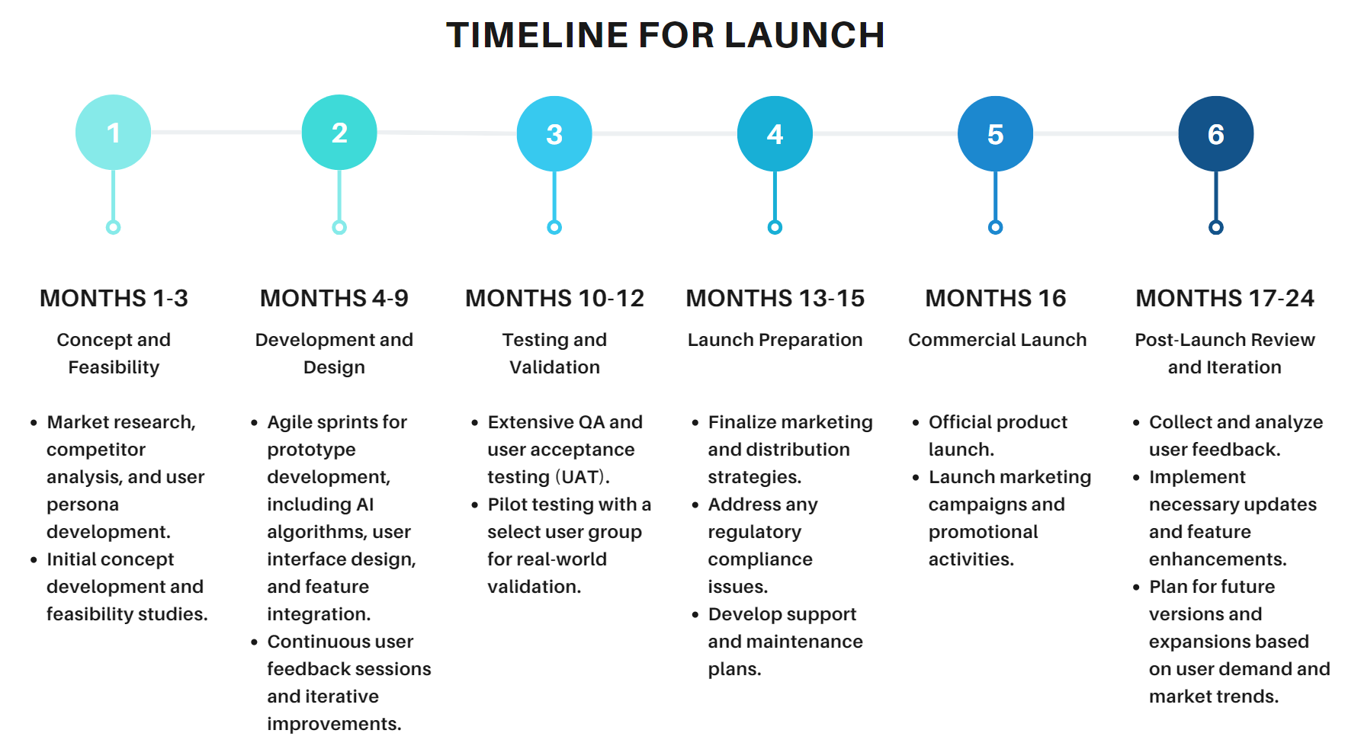

Slide 17
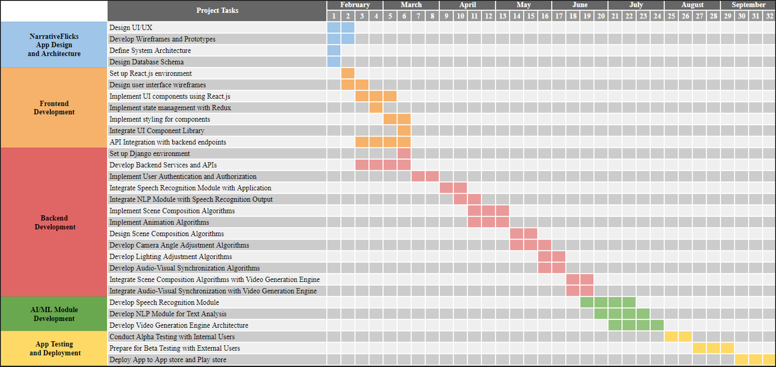

Slide 18
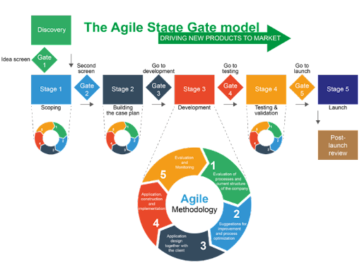
Product Development Methodology - Hybrid
Agile
Iterative design, development, and testing phases
Flexibility in responding to changes
Incorporating user feedback rapidly
Stage-Gate Process
Structured decision points (gates)
Applied to the overall project management, including market research, business case development, and commercial launch planning

Slide 19

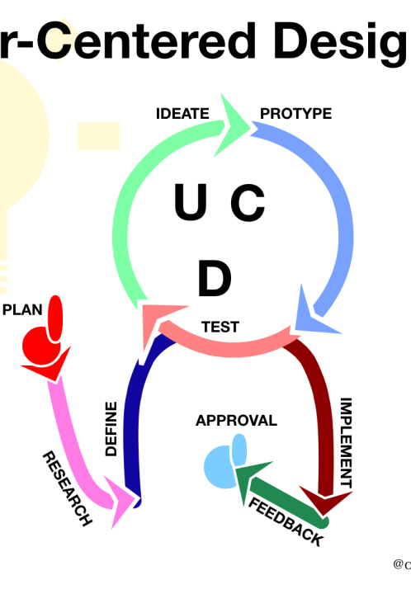
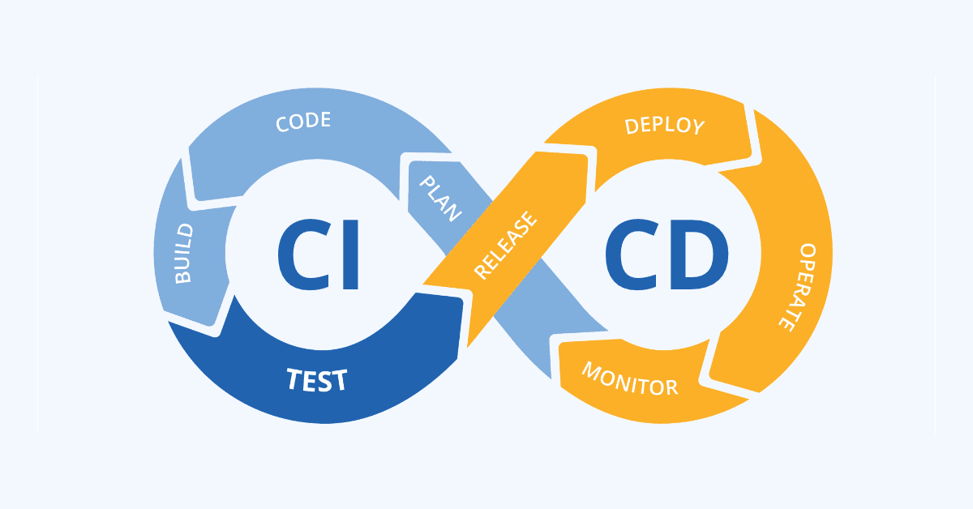
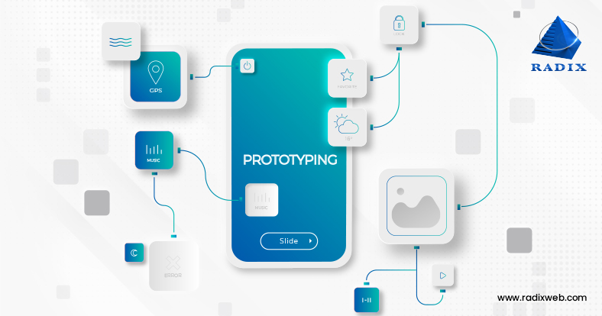
Other Product Development Processes
User-Centric Design
Prototyping and Testing
Continuous Integration and Deployment
Quality Assurance (QA) and Testing

Slide 20

Marketing strategies
Influencer Collaborations: Partner with influencers to showcase the app's capabilities through sponsored content and tutorials.
Social Media Campaigns: Use engaging video teasers, user-generated content contests, and hashtag campaigns to increase visibility.
Educational Webinars and Workshops: Offer webinars and workshops for educators and businesses to demonstrate the app's utility in educational and professional settings.
Email Marketing: Develop a segmented email marketing strategy to reach potential users with personalized messages and offers.

Slide 21

Meet the Team
Pujitha Sai Tulasi Muddhu
Neha Neelkant
Venkata Vaibhav Gajula
Amit S Jadhav

Slide 22


